Slide 1
App Store: Trust & Safety
Aman Kumar
March 2022

Slide 2
Executive Summary
Objective:
Analyze Data for App store performance & Safety
Grouping accounts into meaningfully different segments and analyzing their behavior
Grouping apps into meaningfully different segments
Results At Glance:
Free App with monetary transaction purchases were found
Subscription App with low retention should be monitored
Consumer App with low retention should be monitored
Accounts with unusual transactions should be monitored
70,035 accounts were found with no transaction history
219 accounts with unusual transactions should be monitored
1500 new accounts ~less than 30 days accts with high transaction volumes should be montored

Slide 3
Data Overview
App
Account
metadata on App
metadata on accounts
Device
Category
metadata on devices
metadata on app categories
Transaction
In App Purchase
daily downloads and purchases of both apps and in-app content in the App Store
metadata on in-app content that can be purchased through a given app

Slide 4
Data at Glance

Slide 5

01.
Data Issues
App , account & transaction data

Slide 6
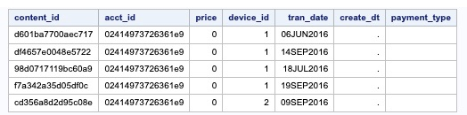
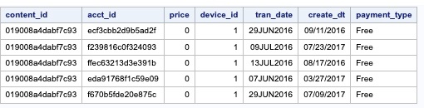
Account & Transaction Data Issues
25 users with different format of Account Key in transaction table had no matching data in account table
3487 users had account created with date after transaction
Users with no account created date found
25 Accounts
Users with a transaction date that precedes account created date
3487 Accts

Slide 7
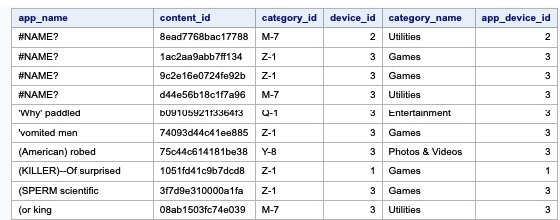
App Data Issues
App with name not defined
“ #Name? “ found in categories like Utilities and Gaming
App Name issue
1 App

Slide 8
02.
Untrusted App
App , account & transaction data

Slide 9
Free App
Fraud apps are prevalent in Gaming & Photo categories
Most of the Fraud app are made for both iPhone & iPad
Free App with monetary transaction purchases were found
Fraud app | #users | $transaction
300 | 14993 | $ 1,025,946

Slide 10
In Purchase App : Subscription
Most of the low retention app in app purchase are made in the Entertainment category
Most of the low retention app are made by for both iPhone & Ipad
Subscription app with low retention :less than 5%
of the users use subscription more than once
#Sub_App | app low retention | # users | $ transaction
60 | 10 | 6024 | $ 62,551

Slide 11
In Purchase App : Consumable
Most of the low retention apps in app purchases are made in the gaming category.
Most of the low retention app are made by for both iPhone & Ipad
Consumable apps with low retention :Less than 5% of users
Use the content of consumption app more than once
#Con_App | app low retention | # users | $ transaction
414 | 67 | 23,810 | $ 348,048

Slide 12
03.
Untrusted Accounts
App , account & transaction data

Slide 13
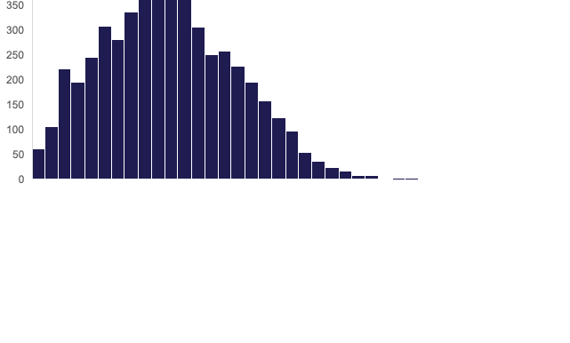
Users with Unusual Transactions
219 unusual users account for 10% of App store purchases,
Abnormal Activity suggest account take over or robot.
Unusual transaction = Average + 3 * Standard Deviation
219 users are having unusual transactions per day( count and amount)
Users having more than 7 transaction/day were shortlisted
Users having more than $66/day were shortlisted
$66

Slide 14
04.
Cluster Similar Accounts/Apps
5%
55%
40%

Slide 15
Accounts Clustering
K-means method was used for clustering similar accounts
Elbow method used to find optimum number of clusters
Cluster1:low active users with no In App purchases or Subscription :14993 Accts
Cluster2:Medium active users with average purchase of $1,100: 14832 Accts
Cluster3 :Highly active users with average purchase of $11,000:150 Accts

Slide 16
App Clustering
K-means method was used for clustering similar accounts
Elbow method used to find optimum number of clusters
Cluster1:Apps which are used by less than 10% of the user :970 Apps
Cluster2: Apps which are used by almost 30% of the user : 24 Apps
Cluster3 : App which are used by almost 60% of the user : 2 Apps

Slide 17
05.
KPI Dashboard

Slide 18
Top & Bottom 5 Downloaded App

Slide 19
Lowest Retention Apps

Slide 20
Transaction Per Day Over Time

Slide 21
Next Steps
Gather more data and come up with better recommendations
Data Required:
APP Reviews
App Created
Discount in In App purchase
Developer name found in App

Slide 22
THANKS!
Have Any Question?

Slide 23
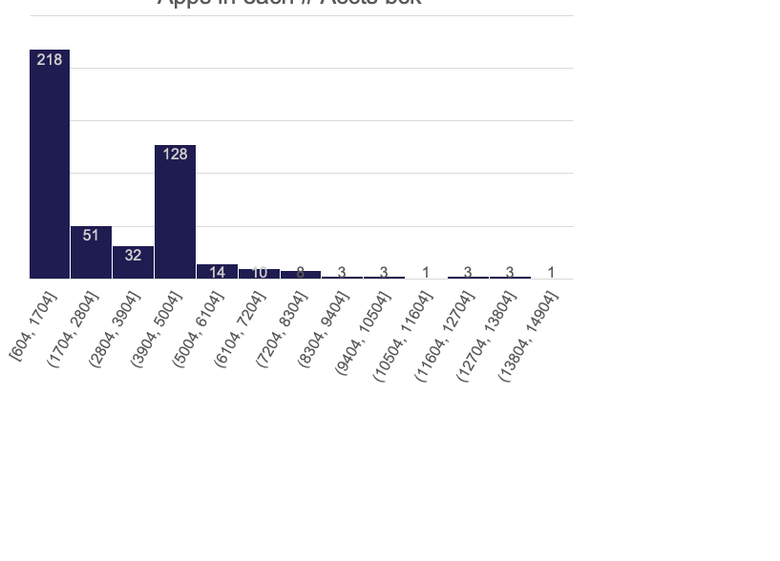
App KPI

Slide 24
Activity of Frd Accts
Unusual 219 Accts
Abnormal Activity suggest ATO or Robot
219 Accts were having unusual count & Amt transaction per day

